Slide 1

GPipe: Easy Scaling with Micro-Batch Pipeline Parallelism
Bhagyashrere Taleka

Slide 2

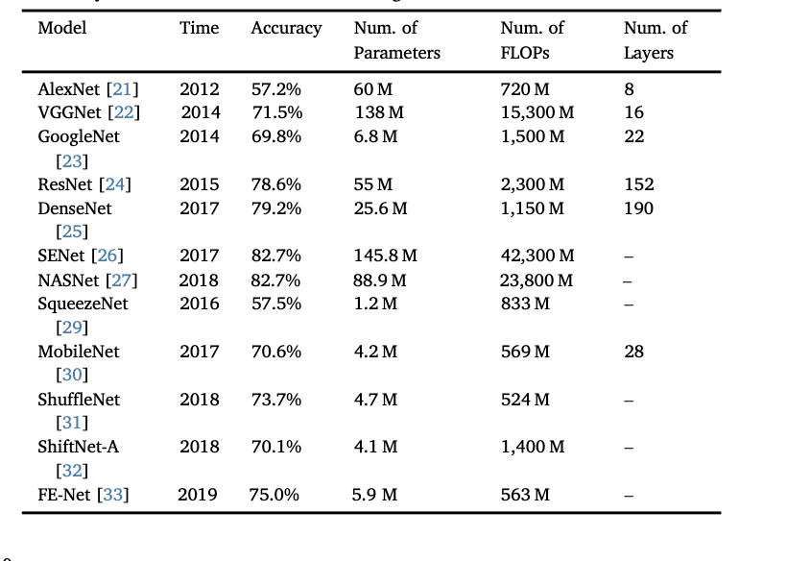
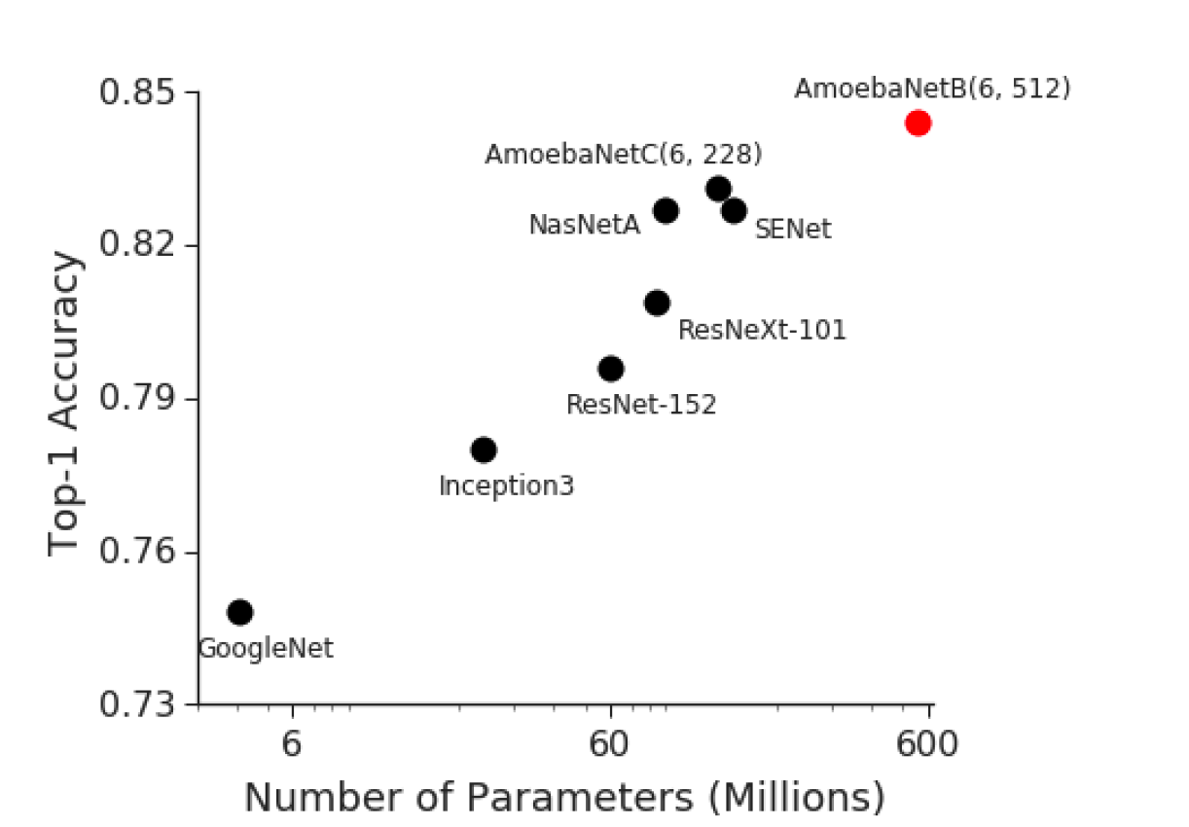
Background and Motivation: huge models
Increasing size of models dramatically improves task performance
Notes:
Convolution based models and transformers are the most prominent Dl workloads. The images in the slide here says that if you increase the params in the model your task perormance singificantly improves. For convolution based models, imageNet visual recognition challenge is one of the classic challenge where researches develop accurate model to classify the images on the given dataset.In the left hand image we see improve in performance over the years due to increase in the model size. Same trend is witnessed on the right hand image as well.This image here represents top-1 accuracy of various models on ImageNet Validation set. Red dot shows 84.3% accuracy(top-1) accuracy of the AmoebaNet model trained by Gpipe. Each of these works demonstrated that increasing size of models improves the task performance.
There are 6 normal cell layers (L = 6), meaning the model has 6 blocks of layers that extract features while maintaining the input's spatial resolution.Each layer has a filter size of 512 (D = 512), meaning there are 512 filters or channels used for feature extraction at each layer.

Slide 3
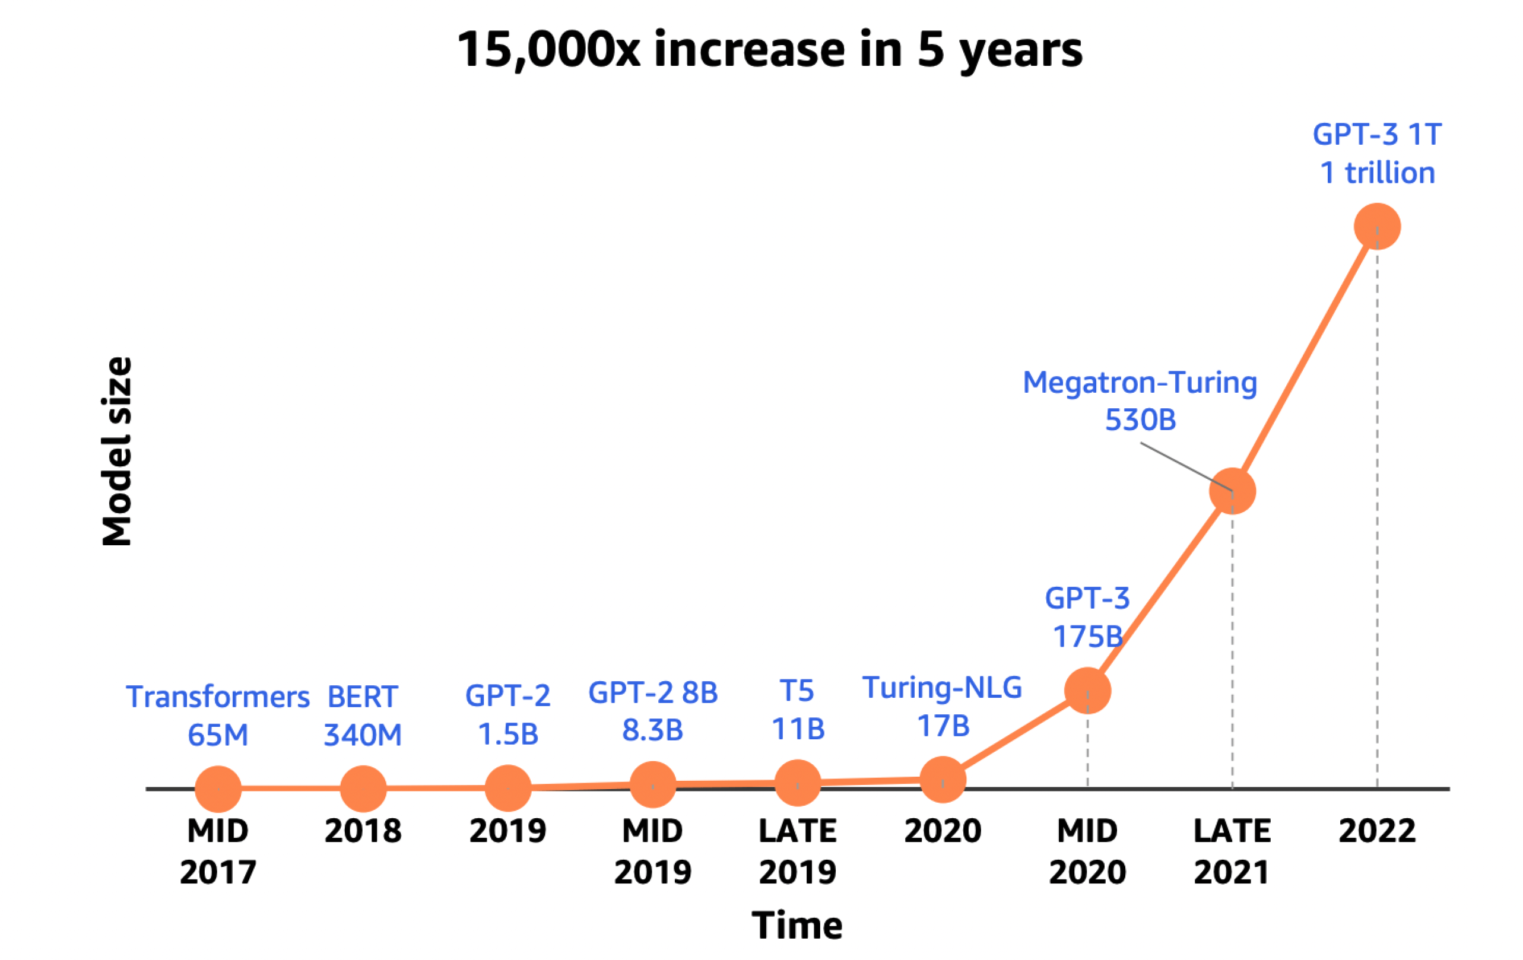
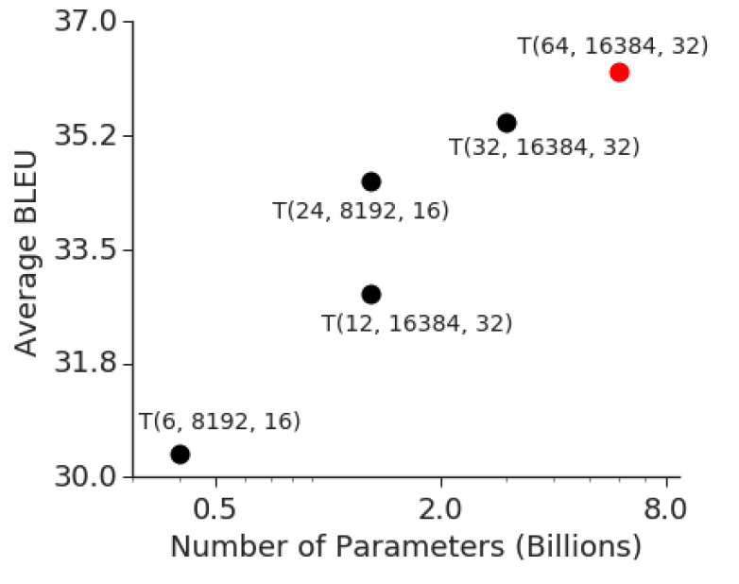
Background and Motivation: Huge Models
Increasing size of models dramatically improves task performance
Notes:
. You can assume the same applies for transformer models as well. Model size has been growing exponentially over the years from 65M transformer tl GPT-31T

Slide 4
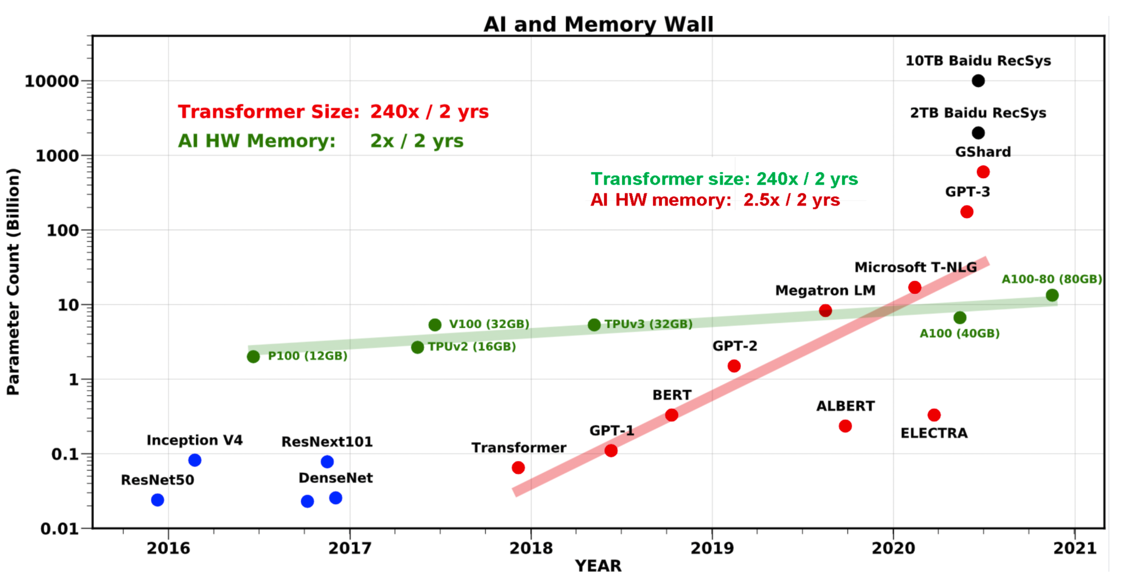
Background and Motivation: Huge Models
Need to push the memory limits of accelerators or scale up the deep neural networks
Notes:
If you plot the trend of increase in model parameter count and memory size of accelerator, we can notice that parameter count almost increases exponentially where as memory size is not. Hence we cannot trasin bigger models in single accelerator. So either push the memory limits of accelerators or scale up deep neural workloads.
Now pushing memory limits is not viable options for 3 reasons
There is no technology that can scale HBM beyond what is available.
Power consumption is huge for running these huge models on accelerators as when you scale the HBM bandwidth, power consumption increases
price for the raw materials, replacing HBM with something else is infeasible
Scaling up of dn workloads is the go to option but it is noteaseir for these reasons
Scaling DL workloads is not easier because of
Hardware constraints
Memory limitations and communication overhead
Model-parallelism algorithms are tailored specific tasks.
Overall, Transformer parameters grow by 410x and accelerator memory has grown by 2x every two years making these large sized models difficult to fit in single accelerator due to memory limit issues
Moreover single accelerator needs to process large-scale datasets, activations and gradients.
Scaling DL workloads is not easier because of
Hardware constraints
Memory limitations and communication overhead
Model-parallelism algorithms are tailored specific tasks.
Scaling up deep neural architecture gracefully is elegant solution rather than pushing the memory limits of single accelerator as models keeps on growing and its impossible to fit in single, cost of single gpu is not cost-effective for small scale research organizations so on
There are 3 reasons why you cannot scale memory of single accelerator for 3 reasons

Slide 5
Background and Motivation: Proposed Solution
Enables scaling of any deep neural architecture
Splitting of mini-batch of training examples into micro-batches.
Partitions model across n accelerators and supports re-materialization on every accelerator
Notes:
. Need to check how different version of models knowledge cutoff influence on accuracy

Slide 6
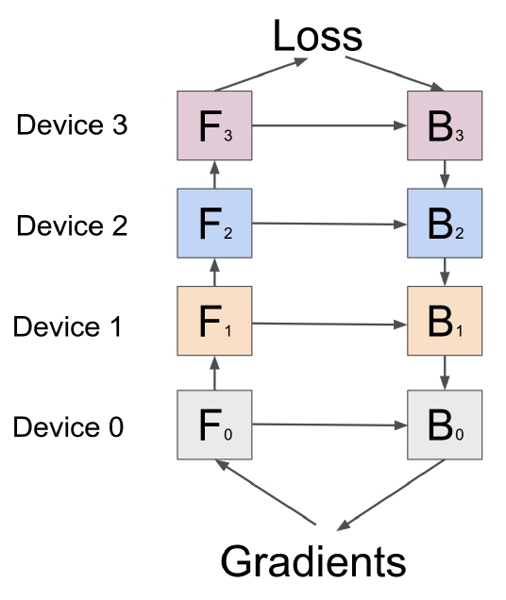
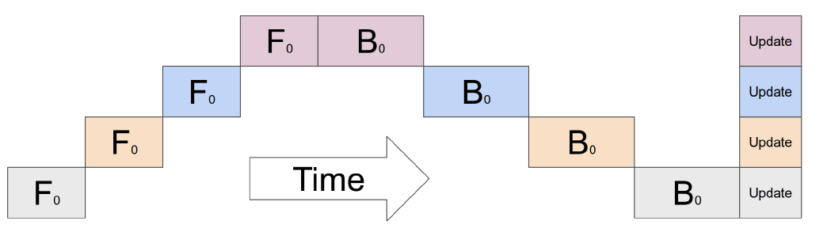
Related Work: Neural Network with Naïve Model Parallelism
Severe under-utilization of hardware and introduces bubble time
Notes:
When scaling DL models, first approach everyone thinks is model parallelism.But, naïve model parallelism leads to under-utilization of hardware and introduces device communication bottlenecks. For instance, divide model and sistribute across n accelerator. Minibatch is pipelined through each one them. Now this scheme introduces idle time of gpu leading to sever under-utlilization of the gpus

Slide 7
Related Work
Mesh-TensorFlow: General purpose tensor splitting strategy over several accelerators.
Communication Overhead: Partitions needs to be synchronized frequently
Suitable for applications with minimal inter-device communication or when high-speed interconnects are available.
Notes:
So, SPMD and pipeline-parallelism is the go to solutions for this problem.
Since we have split across n accelerators and this is general purpose splitting strategy we need to synchronize more frequently. This introduces communication overhead as we use all-reduce kind of operations.

Slide 8
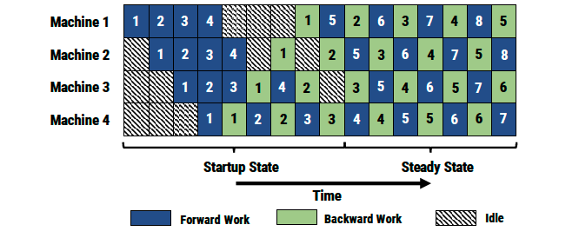
Related Work: Pipeline Parallelism
PipeDream: Aims to maximize hardware utilization.
Multiple copies of weights on the accelerator prevents scaling to bigger models
Notes:
2nd approach to scale the DL workloads is pipeline parallelism. Earlier work is from Microsoft called PipeDream. This work aims to maximize hardware utilization
Start up state most of gpu is in idle state waiting for the minibatches to go through pipeline. In steaduy state we see gpus are filled and not sitting idle processing the minibatches.
This work uses async backward updates ato improves harwarde utilization where backward pass of a minibatch may happen much later than its forward pass. For example, consider machine working on 4th batch. Its forward pass is happening 7th timestamp where as its backward pass is happening at 12th timestamp. Now between 7th and 12th timestamp weights of the model has been updated multiple times. However, backward pass of 4th minibatch should use the weights from its forward pass and not from the weights of 5th batch’s forward pass. Hence, we store multiple version of weights of a mibatch(forward pass) in the accelerator memory to compute gradient updates properly.

Slide 9
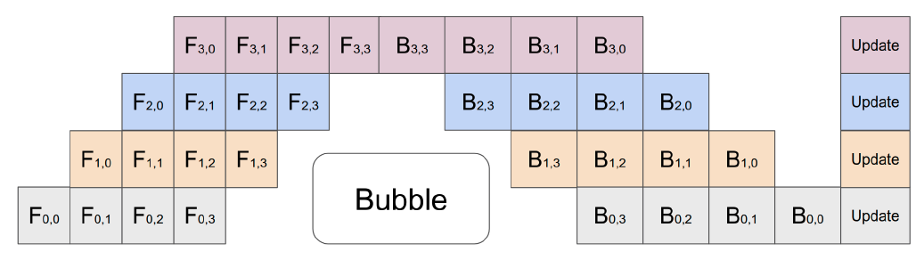
Key Ideas: Algorithm
Partition layers into cells and divide the mini-batches into micro-batches
Notes:
. Need to check how different version of models knowledge cutoff influence on accuracy

Slide 10
Key Ideas: GPipe Interface
User defined parameters
The number of model partitions K
The number of micro batches M
The number of layers L in the model
[optional] cost estimation function
Let partition p_{k} consist of consecutive layers between i and j
Parameters: union of w_{i}, w_{i+1},w_{i+2}…….w_{j}
Forward function F_{k} : f_{j}(……(f_{i+1}(f_{i}))…)
Backward function : computed from F_{k}
Cost estimator : summation of individual costs
Notes:
Algorithm might sound complicated but user need not worry about implementing them as Gpipe does it for you

Slide 11
Key Ideas: Algorithm
Gpipe partitions network into K cells
K-th cell is placed on K-th accelerator
Communication primitives are inserted at partition boundaries.
Every mini-batch is divided into M micro-batches and pipelined through K accelerators.
At the end of each mini-batch, gradients from all M batches are accumulated and updated across all accelerators.
Notes:
. Need to check how different version of models knowledge cutoff influence on accuracy

Slide 12

Key Ideas: Performance Optimization
Re-materialization used to reduce activation memory requirements
Memory requirement reduced from O(N x L) to O( N + $\frac{L}{K}$ x $\frac{N}{M}$) .
The bubble time becomes negligible when M $≥$4 x K.
GPipe has low communication overhead.
However, GPipe assumes partitions are evenly balanced.
Notes:
. Need to check how different version of models knowledge cutoff influence on accuracy
O(NxL) is memory requirements without partitioning and re-materialization. N=minibatch size and L =num layers. This is because you need to store activation for all N samples at every layer.
However with partitioning and re-materialization, it is reduced to N+L/k*N/M where N = for storing the activation of N samples art partition boundary and O(L/K*N/M) is rematerialiation cost for storing re-computed forward activation of its partition where L/K partitions stored in the accelerator and it process N/M minibatch smaples
Bubble time = total number of bubbles/pipeline steps ; time taken to proc

Slide 13
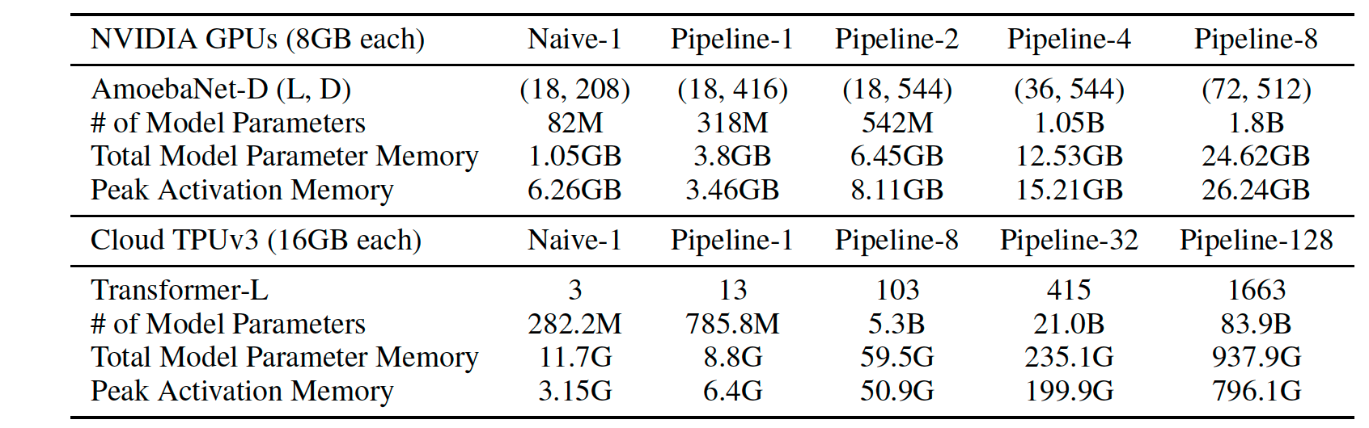
Performance Analysis: Scalability
Notes:
. They expect both re-materialization and pipelione parallelism to benefit memory utilization thus make fitting giant models feasible. Without Gpipe, single GPU could fit82M parameter model. However, with re-materialization and batch splitting on same songle GPU they could accommodate 318M model reducing activation memory from 6.26GB to 3.46GB. With model parallelism, the could scale uprto 1.8GB model on 8 accelerator. For amoebanet model size did not linearly scasle with number of accelerators due to imbalance dsitributioon of model params over different layers in amoebanet

Slide 14
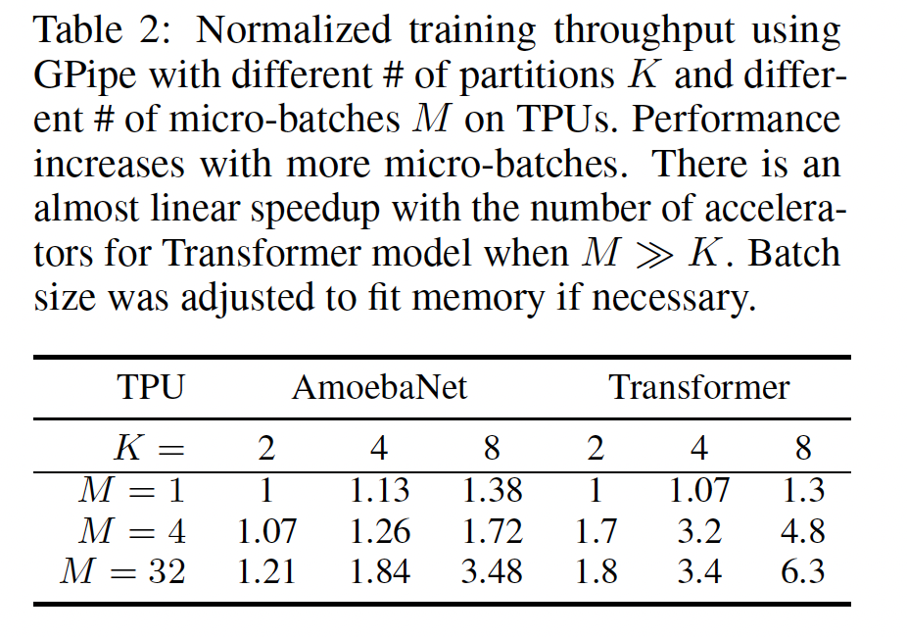
Performance Analyses: Efficiency
Notes:
Normalized training throughput is the rate at which a model processes data during training, adjusted for factors like model size, batch size, and hardware differences. Here they varied # of acceleratoes and partitions and accelerators. They observed bubble time not apparentwhen microbatch size > 4*K.
For transfotrmers, they observed training throughput scaleslinearly with number of devices.Amebanet achieves subpar speedup due to imbalanced distribution.
When M=1 there is no parallelism , regardless of the number of accelerators, through remains relatively constant.

Slide 15
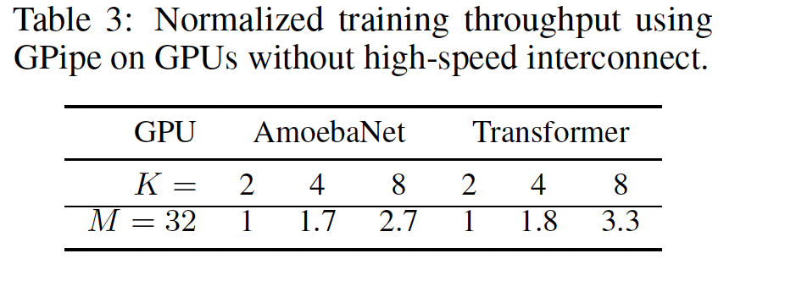
Performance Analyses: communication overhead
Communication bandwidth between devices is no longer a bottleneck for model parallelism
Notes:
They ran experiments on NVIDIA P100 GPU without NVLinks. So data transfer has ot be through PCI-e bus ewhich is relatively slower comparted NVLINK. There is 2.7x speedup and 3.3x sppedup for transformer
Communication bandwidth between devices is no longer a bottleneck for model parallelism since gpipe transfrer activation tensors at boundaries of partiutions

Slide 16
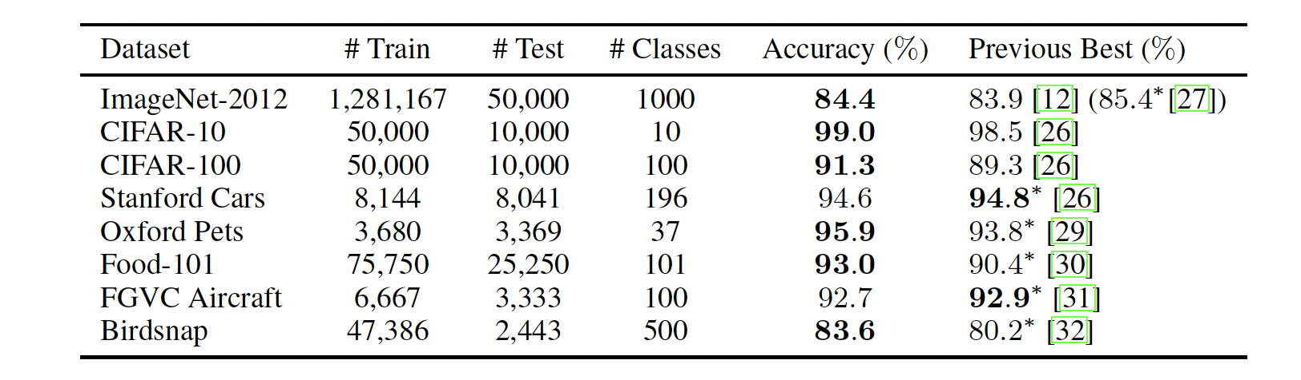
Results: Image Classification
Notes:
. Need to check how different version of models knowledge cutoff influence on accuracy.

Slide 17
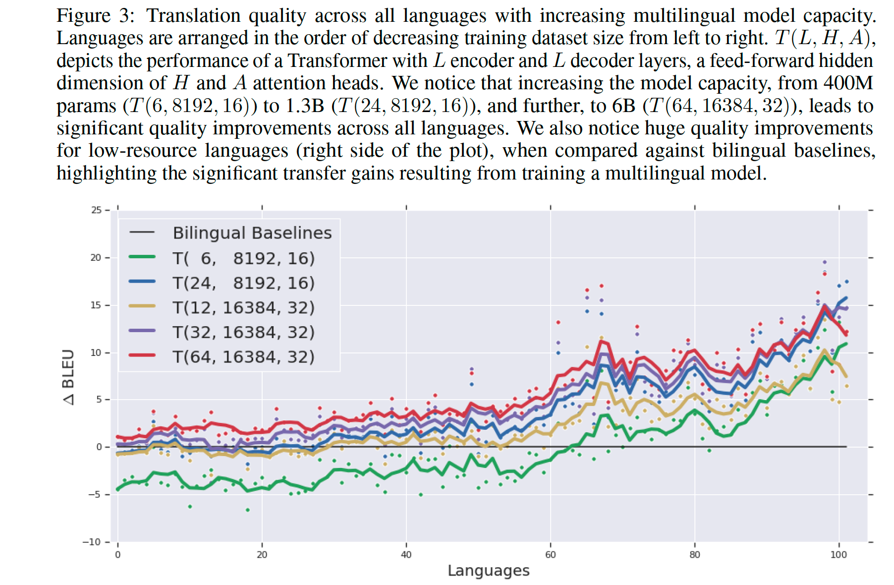
Machine to Machine Translation
Notes:
They scaled the architectures by increasing number of layers and increasing the hidden dimension in FFN layers and increasing number of attention heads
Increase in depth helps to increase the deep model performns on low-resource languages. Blue and yellow lines

Slide 18
Purpose of design choices
Improved pipeline parallelism algorithm
Micro-batching and re-materialization to improve hardware utilization and enhance memory requirements respectively
Strong scaling throughput increase.
Notes:
To overcome memory limitations of single accelerator and scale deep neural network architectures more efficiently
Strong scaling you keep the computation FLOPs constant and increase number of computational iunits like GPU

Slide 19
Strengths
Generalizable parallelism strategy across various DL workloads.
Scalability
Memory efficient algorithm
Cost estimator function
Notes:
. Need to check how different version of models knowledge cutoff influence on accuracy

Slide 20
Weakness and Future directions
Assumes partitions are evenly balanced.
No effective measures to overcome bubble time.
Assumes number of partitions = number of accelerators
Fault tolerance mechanisms needs to be addressed.
Notes:
Future improvements could include more sophisticated ways to dynamically partition and rebalance workloads to further enhance resource utilization.
Combining GPipe's pipeline parallelism with data parallelism and model parallelism can create more efficient hybrid models. The integration of these methods could enhance the scalability and reduce bubble time further
What if one of gpus is down? Do you redistribute the model layers on to other accelerators? What if it exceeds gpu memory?

Slide 21
THANK YOU
Notes:
Future improvements could include more sophisticated ways to dynamically partition and rebalance workloads to further enhance resource utilization.
Combining GPipe's pipeline parallelism with data parallelism and model parallelism can create more efficient hybrid models. The integration of these methods could enhance the scalability and reduce bubble time further
What if one of gpus is down? Do you redistribute the model layers on to other accelerators? What if it exceeds gpu memory?

